Slide 1

Emotion Analysis on Bengali Song Lyrics

Slide 2



team
Ashiqul Islam
Alam Khan
Mehedi Hasan
ID: 170204070
170204070@aust.edu
ID: 170204084
170204084@aust.edu
ID: 170204096
170204096@aust.edu
Submitted To:
Faisal Muhammad Shah, Associate Professor
Md. Tanvir Rouf Shawon, Lecturer Department of Computer Science and Engineering
Ahsanullah University of Science and Technology

Slide 3
Introduction
❏ Songs are a way to express our emotion and harmony through vocal or instrumental sounds or both
❏ Songs control our emotions and make our minds cheerful and joyous and reduce loneliness
❏ Different cultures can have very different approaches to songs, lyrics, and melody
❏ Whether we sing or speak the lyrics, we can feel a pattern or pulse in the way the words move the song forward
❏ Here in this project we will analyze songs lyrics and detect the lyrics as sad songs or not sad songs

Slide 4

Literature Review

Slide 5
Human resources slide 3
Combining content and sentiment analysis on lyrics for a lightweight emotion-aware Chinese song recommendation system [1]
Textual lyrics based emotion analysis of Bengali songs[2]
Most
Popular Approaches
V. X. Chen and T. Y. Tang, 2018.
Devjyoti Nath et al, 2021.

Slide 6

Data Collection & Preprocessing

Slide 7

Data collection & preprocessing
❏ Our project dataset was collected from various open-source Websites of Bengali song lyrics which are publicly available
❏ We collected 1000 Bengali song lyrics to evaluate our model
❏We manually label the dataset as Sad =1 and not sad =0
Data Collection

Slide 8
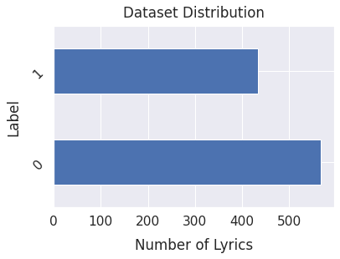
Data Distribution
❏ There are 1000 Bengali lyrics in our dataset among them 567 not sad song and 433 sad song

Slide 9

Methodology

Slide 10
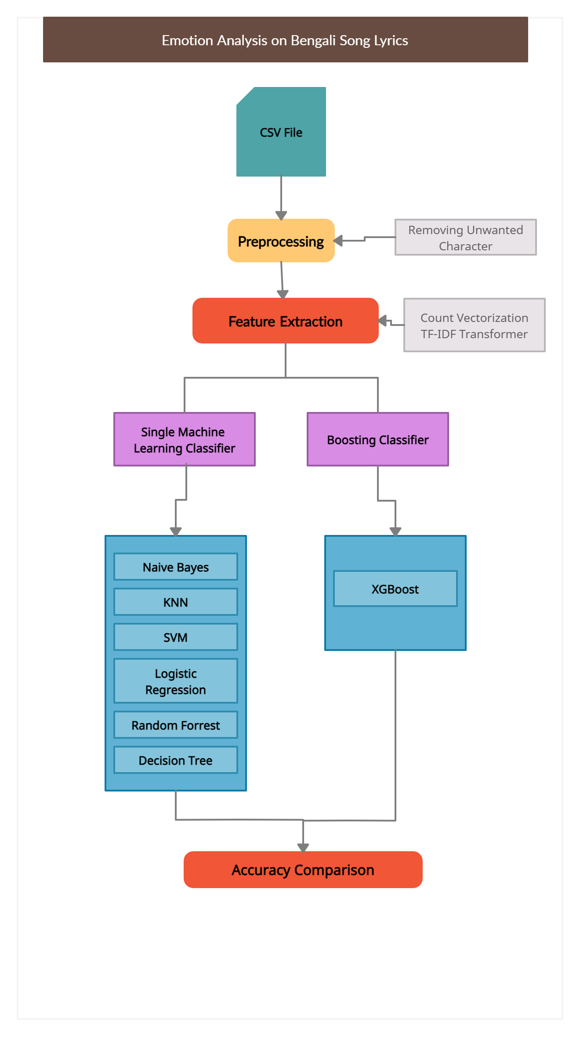

Slide 11
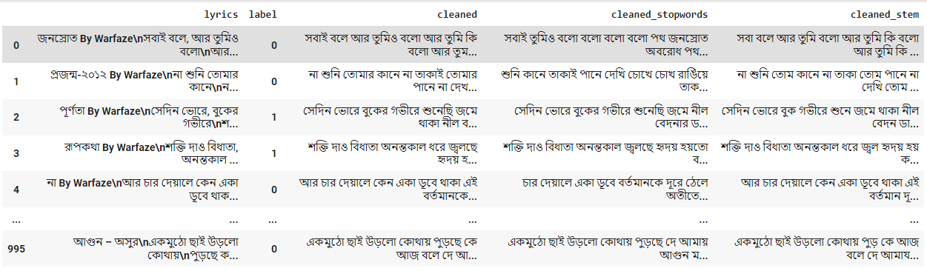
Dataset Preprocessing
❏ In preprocessing part we remove white space, comments, quotation symbols or other un-wanted characters from the dataset
❏ Removing stopwords to remove irrelevant words from the dataset
❏ Use word stemming to get the root words
❏ feature extraction part we use count vectorizer, tfidf transformer, bigram and trigram model

Slide 12
Working Procedure And Experiments

Slide 13
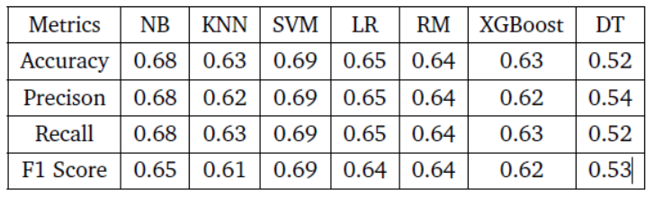
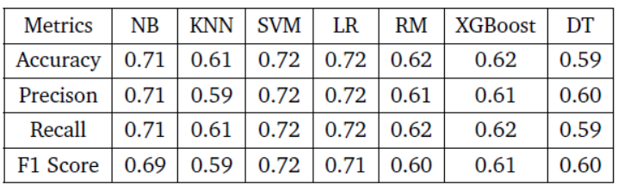
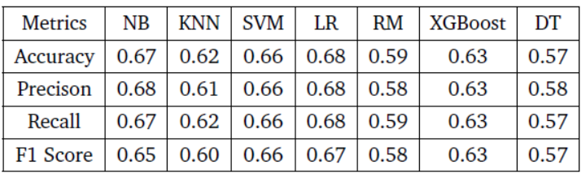
Experiment 1
TF IDF Vectorizer
Remove StopWords
Word Stemming

Slide 14
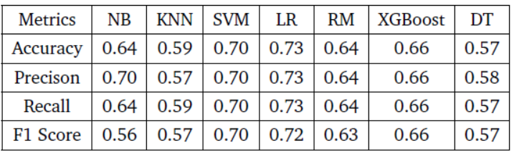
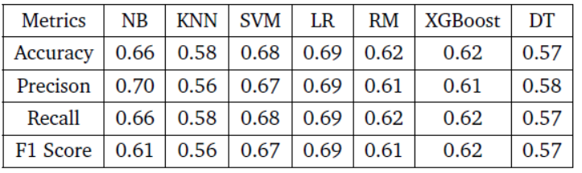
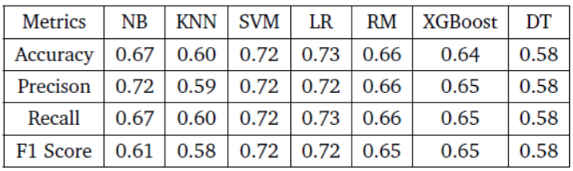
Experiment 2
TF IDF Vectorizer with Bigram
Remove StopWords
Word Stemming

Slide 15
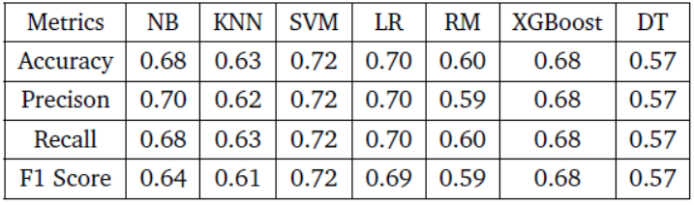
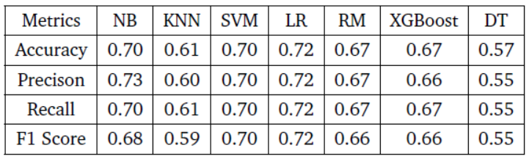
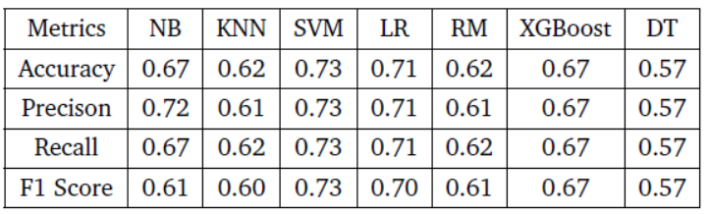
Experiment 3
TF IDF Vectorizer with Trigram
Remove StopWords
Word Stemming

Slide 16

Human resources slide 7
Combination of all features with weight:
0.73
0.73
Accuracy
Precision
0.73
0.73
Recall
F1 Score

Slide 17
Future Work
❏ Increase dataset using web scrapping
❏ Use Neural Network to increase accuracy
❏ Finding some other dataset of bangla song lyrics
❏ Comparing our model with other language dataset to evaluate our model performance

Slide 18
References
[1] V. X. Chen and T. Y. Tang, “Combining content and sentiment analysis on lyrics for a
lightweight emotion-aware chinese song recommendation system,” 2018 10th International
Conference on Machine Learning and Computing, pp. 85–89, 2018.
[2] S. K. S. A. G. S. P. Devjyoti Nath, Anirban Roy, “Textual lyrics based emotion analysis of
bengali songs,” 2020 International Conference on Data Mining Workshops (ICDMW), 16
February 2021.

Slide 19

THANKS
Does anyone have any questions?

